Slide 1
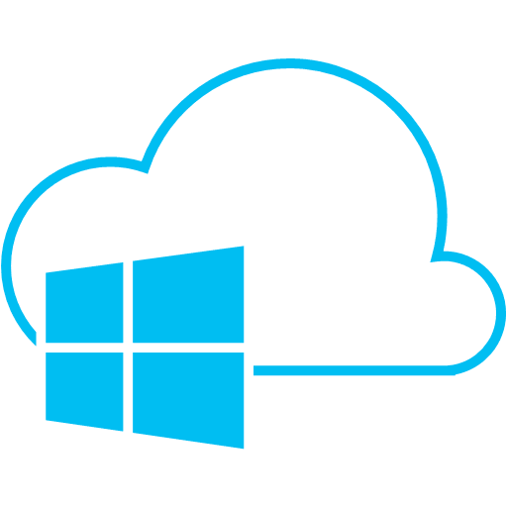
Microsoft Azure
Brief Overview and Creation of Test Website
Notes:
introduction

Slide 2

What is Microsoft Azure?

Slide 3
From Official Website
“Azure is Microsoft’s cloud computing platform, a growing collection of integrated services - analytics, computing, database, mobile, networking, storage, and web - for moving faster, achieving more, and saving money.”
http://azure.microsoft.com/
Notes:
Добавить рамку

Slide 4
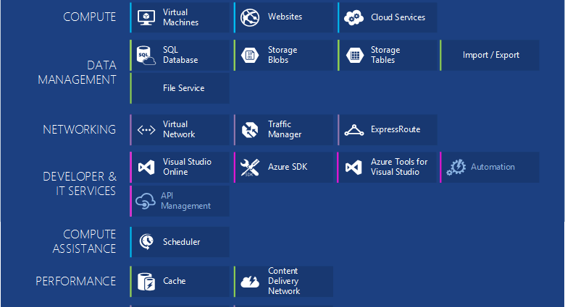
Azure Components
Notes:
https://azure.microsoft.com/en-us/documentation/articles/fundamentals-introduction-to-azure/
Icons:
https://www.amido.com/azure-icons-for-lucidchart/

Slide 5
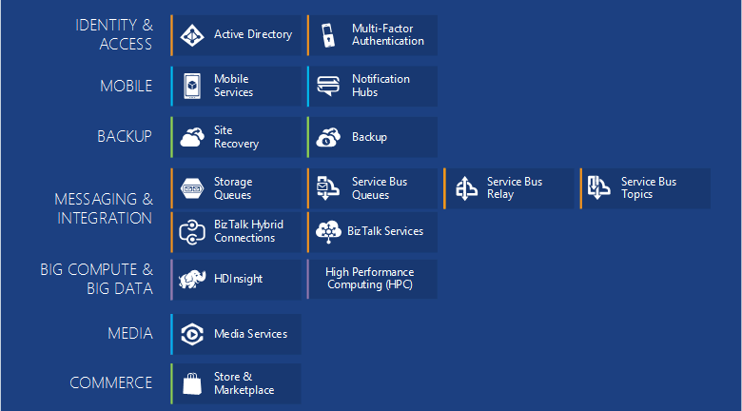
More Azure Components
Notes:
https://azure.microsoft.com/en-us/documentation/articles/fundamentals-introduction-to-azure/

Slide 6






Cloud Solutions
War of Attrition
Notes:
Slides “Windows Azure vs. Amazon AWS”:
http://www.slideshare.net/tekcraft/azure-vsamazon?related=1

Slide 7
Enterprise Public Cloud Usage
Notes:
Information from:
http://assets.rightscale.com/uploads/pdfs/RightScale-2015-State-of-the-Cloud-Report.pdf
http://www.rightscale.com/blog/cloud-industry-insights/cloud-computing-trends-2015-state-cloud-survey
In January 2015, RightScale conducted its fourth annual State of the Cloud Survey of the latest cloud computing trends, with a focus on infrastructure-as-a-service. The survey asked 930 IT professionals about their adoption of cloud infrastructure and related technologies. The respondents ranged from technical executives to managers and practitioners and represented organizations of varying sizes across many industries. The margin of error is 3.2 percent.

Slide 8
Comparison Azure vs AWS

Slide 9
Pricing
Notes:
App Service Pricing:
http://azure.microsoft.com/en-us/pricing/details/app-service/

Slide 10

Azure Geography
Azure operates out of 17 regions around the world
Notes:
http://azure.microsoft.co
AZURE REGION LOCATION
Central US Iowa
East US Virginia
East US 2 Virginia
US Gov Iowa Iowa
US Gov Virginia Virginia
North Central US Illinois
South Central US Texas
West US California
North Europe Ireland
West Europe Netherlands
East Asia Hong Kong
Southeast Asia Singapore
Japan East Tokyo, Saitama
Japan West Osaka
Brazil South Sao Paulo State
Australia East New South Wales
Australia Southeast Victoriam/en-us/regions/

Slide 11
Cloud Service Models
Managed by Customer
Managed by Vendor
Private
(On-Premises)
Infrastructure
(as a Service)
Platform
(as a Service)
Software
(as a Service)
Applications
Applications
Applications
Applications
Data
Data
Data
Data
Runtime
Runtime
Runtime
Runtime
Middleware
Middleware
Middleware
Middleware
O/S
O/S
O/S
O/S
Virtualization
Virtualization
Virtualization
Virtualization
Server
Server
Server
Server
Storage
Storage
Storage
Storage
Networking
Networking
Networking
Networking
Notes:
Windows Azure IaaS vs. PaaS vs. SaaS
http://robertgreiner.com/2014/03/windows-azure-iaas-paas-saas-overview/
Which Windows Azure Cloud Architecture? PaaS or IaaS ?
http://blogs.msdn.com/b/hanuk/archive/2013/12/03/which-windows-azure-cloud-architecture-paas-or-iaas.aspx

Slide 12

Cloud Service Models and Azure
IaaS
Virtual Machines
SaaS
PaaS
Cloud Services
SQL Azure
Storage Tables
Storage Blobs
Cache
Traffic Manager
Mobile Services
Notes:
Windows Azure IaaS vs. PaaS vs. SaaS
http://robertgreiner.com/2014/03/windows-azure-iaas-paas-saas-overview/
IaaS: VM
PaaS: CloudServices, WebSites, SQL Azure
SaaS: WebSites (Drupal, Jumla), SharePoint,
Icons:
https://www.amido.com/azure-icons-for-lucidchart/

Slide 13
Azure IaaS vs PaaS Statistics

Slide 14

From Words to Deeds
Notes:
https://portal.azure.com
https://manage.windowsazure.com

Slide 15
Azure Subscription

Slide 16
How to Manage
From Visual Studio with Azure SDK
From Management Portals:
https://manage.windowsazure.com
https://portal.azure.com (beta)
Using PowerShell Console
Notes:
How to install and configure Azure PowerShell:
https://azure.microsoft.com/en-us/documentation/articles/powershell-install-configure/

Slide 17
Azure SDK and Command-line Tools
Notes:
http://azure.microsoft.com/en-us/downloads/
How to install and configure Azure PowerShell
https://azure.microsoft.com/en-us/documentation/articles/powershell-install-configure/

Slide 18
Tiered Migrations
Take Advantage of PaaS Where You Can
Many Applications could benefit from migrating to a mixed deployment. Migrating to web/worker roles or taking advantage of other Windows Azure services (storage, cache etc..)
Benefits of Web and Worker Roles
Simplified Deployment and Configuration
Health Model
Easy High Availability
Instance Scalability
OS Patching
Automatic Firewall Configuration
Simple Certificate Deployment
Many others

Slide 19


